Slide 1

Death and Life of Great Open Source Projects
Jianchao Yang / Zexi Han
April 19

Slide 2
Projective Objective
Pinpoint different metrics measuring project activity
Detect activity patterns and try to understand what makes a project be in certain pattern
Main hypothesis:
A project is more likely to gain popularity and stay active if it is consistently well-supported, which is reflected in its life cycle pattern.
Death and Life of Great Open Source Projects

Slide 3
Workflow
Identify Metrics
issues, commits and stargazers
project groups by stars & language, weekly activities
Explore Life Cycle Pattern
Resuamable, Repeatable, Reconfigurable
Collect Data

Slide 4
Identify Metrics

Slide 5

GitHub User Behavior Data
Commits
Weekly commit count
Additions/Deletions
Issues
Weekly issues count
Pull request
Issue events
Contributors
Notes:
A commit is an individual change to files. It's like when you save a file, except with Git, every time you save it creates a unique ID that allows you to keep record of what changes were made when and by who. Commits usually contain a commit message which is a brief description of what changes were made.
Issues are suggested improvements, tasks or questions created by anyone related to the repository. Issues are a great way to keep track of tasks, enhancements, and bugs for open source projects. They're kind of like email—except they can be shared and discussed with the rest of your team. Most software projects have a bug tracker of some kind. GitHub's tracker is called Issues, and has its own section in every repository.
Issues activity plays a significant role in representing the vitality of the projects. Thus in our project, we inspect and analyze the issues activity of the projects in the dataset from different issues aspects.

Slide 6
Collect Data

Slide 7
Sampling Seed
Top 1% Popular Projects of Each Language: n = 36,069
Group Name | Group-100 | Group-75 | Group-50 | Group-25
Quantile | 100% | 75% | 50% | 25%
Stargazers max | 167,416 | 959 | 474 | 273
n | 9,013 | 8,990 | 9,004 | 8,998

Slide 8

GHTorrent.org
Popular projects were generated from GHTorrent MySQL dump

Slide 9



Tools Used
MySQL Server on AWS
RStudio Server
Notes:
57 million repositories on GitHub

Slide 10
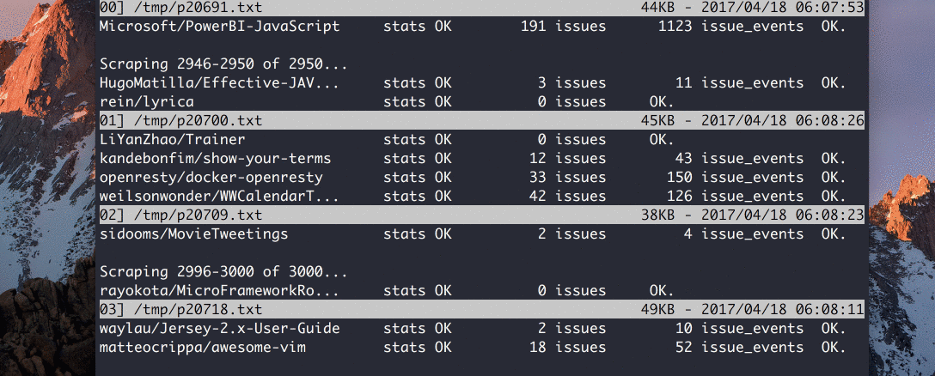
Robust High-efficient Scraping

Slide 11
Robust Scraping
Resumable
Can resume when errors killed the process
Repeatable
Get the same result on other machines
Reconfigurable
Easy to adjust sample size and number of parallel processes
High speed unmanned web scraping that upholds the maximum data integrity

Slide 12
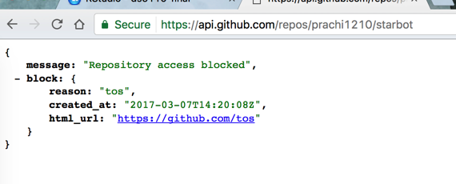
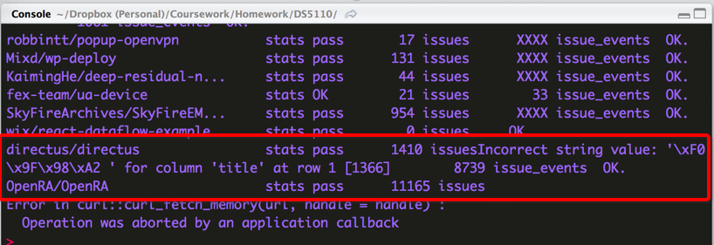
Data Auditing
Shit happens.

Slide 13
It seems even MySQL utf8 cannot handle emojis 😔😔☹️
dbExecute(db$con, "SET NAMES utf8mb4")

Slide 14
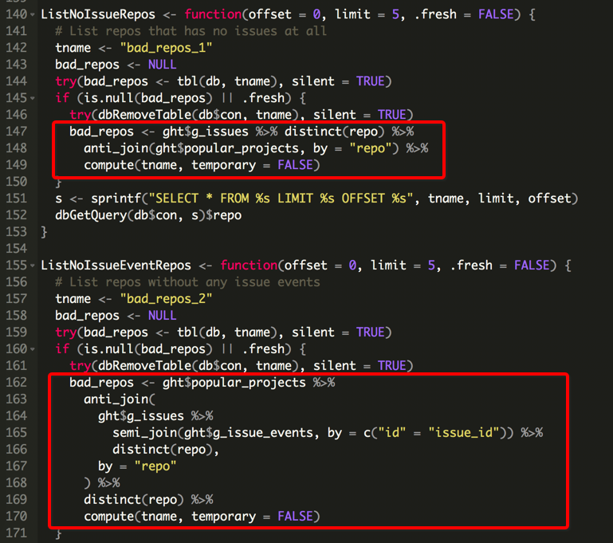
Find Incomplete Repos

Slide 15
Explore Life Cycle Pattern

Slide 16
Commits
Raw data
Weekly commit count
Find the life cycle pattern from the commits

Slide 17
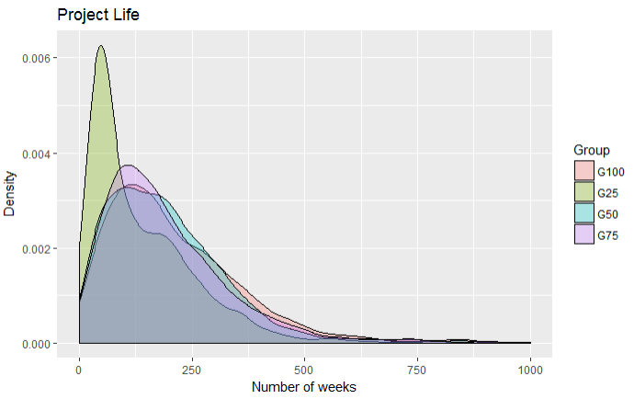
Stargazer groups and project age
Sample the first 2 years
(8 quarters, 104 weeks)

Slide 18
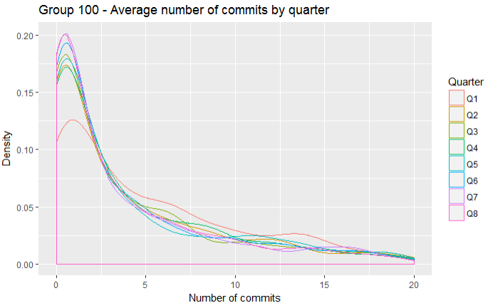
Vertical Quarter Comparison
Number of commits:
Q1 > Q2 >…> Q8

Slide 19
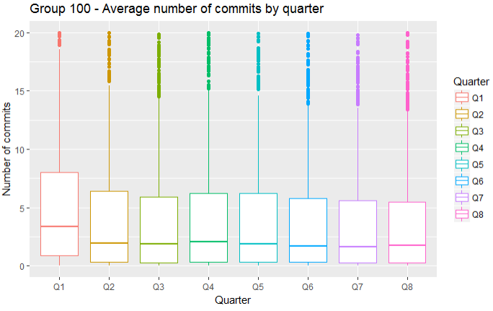
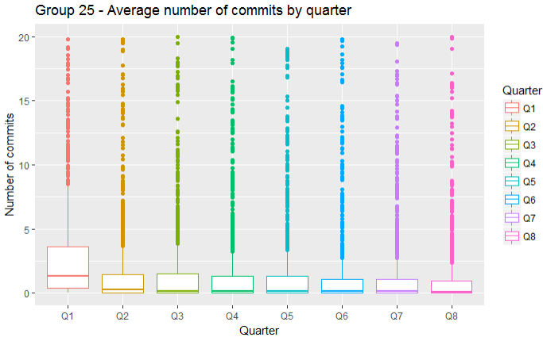
Effort gap

Slide 20
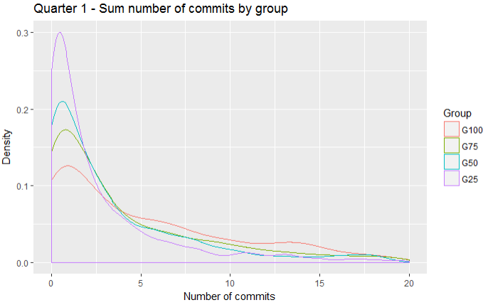
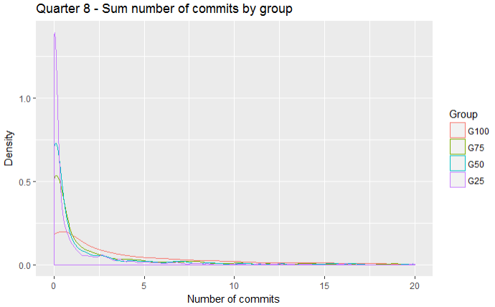
Horizontal Group Comparison

Slide 21
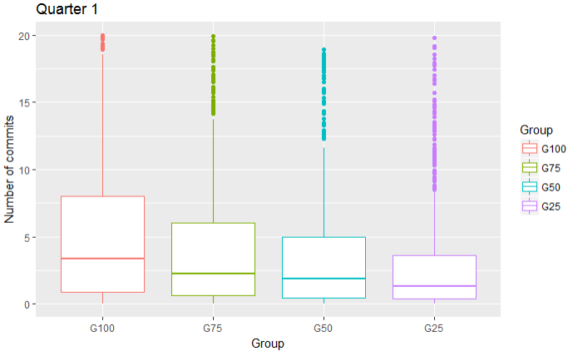
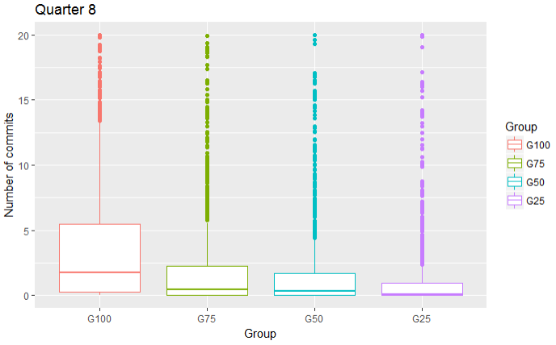
Group Effort Comparison

Slide 22
Explore Life Cycle Pattern
To simplify the problem, we divide the 2 years project life into 3 phases:
Anaphase
Metaphase
Prophase

Slide 23
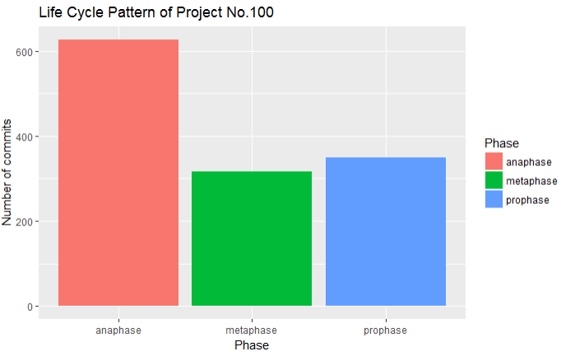
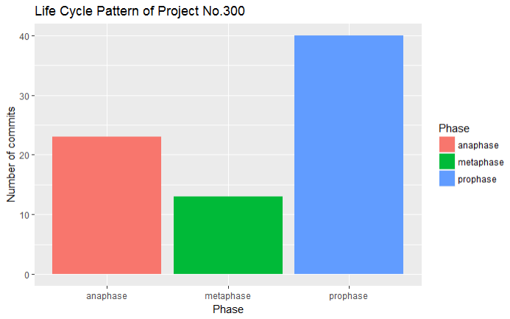
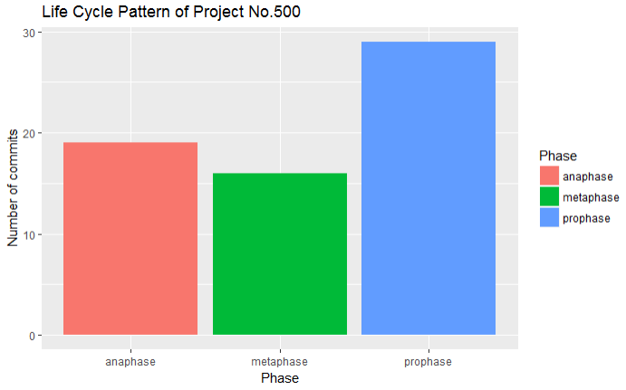
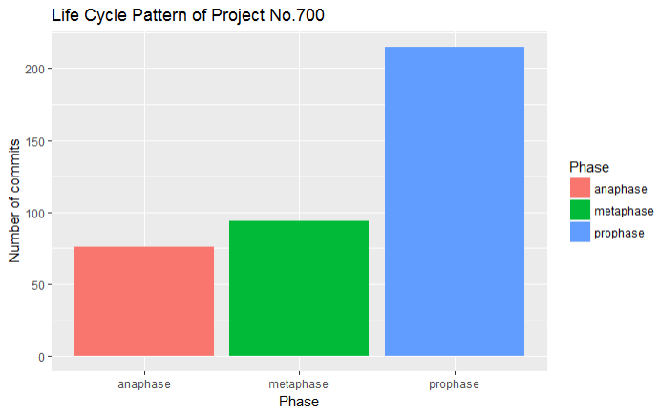
How to get the robust model of the pattern?

Slide 24
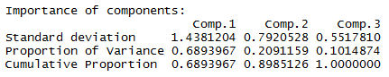
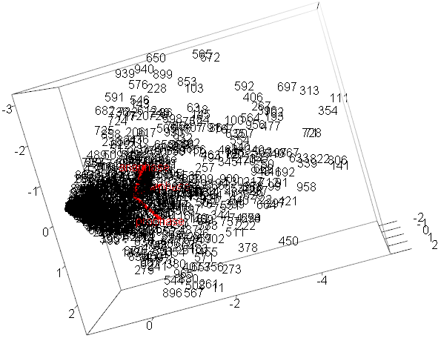
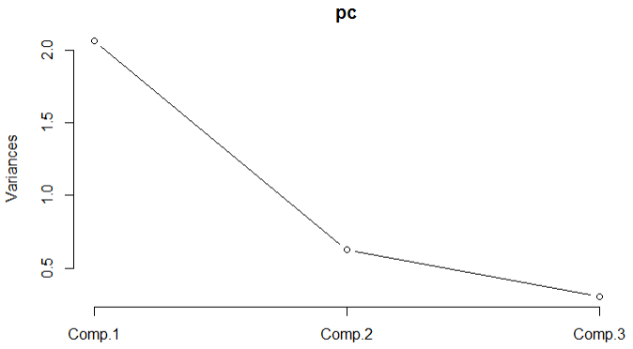
Clustering – Principal Component Analysis
Notes:
cumulative proportion of variance
You can get a similar sort of idea from a scree plot.
You can see how the original variables behave relative to our principal components

Slide 25
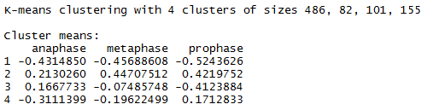
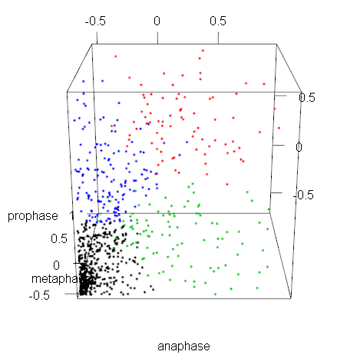
Clustering – k-means
Pattern 1 - Small data points
Pattern 2 - Increase , then stable in high level
Pattern 3 – Start from high level , then decrease
Pattern 4 - Start from low level, then increase

Slide 26
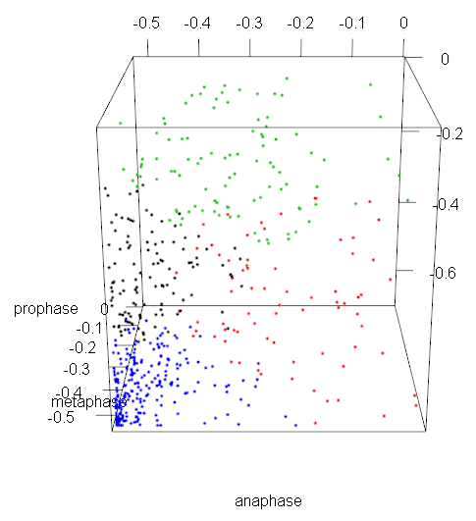
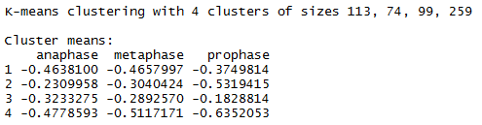
Resolve Pattern 1 – Small Data Points
Same pattern!

Slide 27
Conclusions

Slide 28
What have we done?
Wrote a robust and fast scraper for GitHub data
Experimented different ways to store relational data in MySQL efficiently
Conducted exploratory analysis on the commit activity patterns of projects in different stargazer groups

Slide 29
What’s left to be done
Conduct same pattern detection using issues data
Examine the lag differences between number of commits and issues
Run correlation test for having a certain activity pattern and some project characteristics

Slide 30
Thank You

